Slide 1
Big Data Programming GraphX and GraphFrames Module 2-Lecture 5

Slide 2
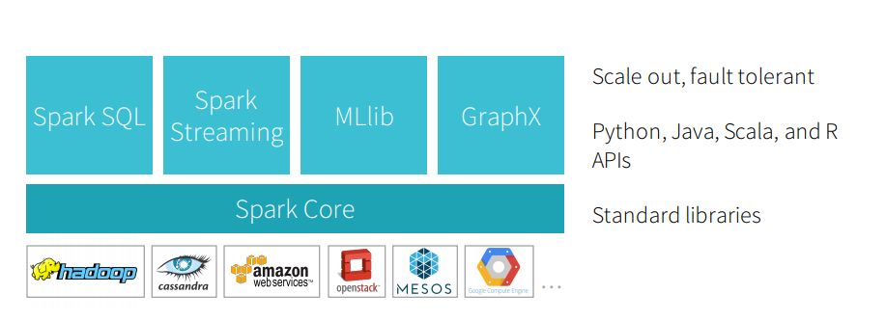
Apache Spark Engine

Slide 3
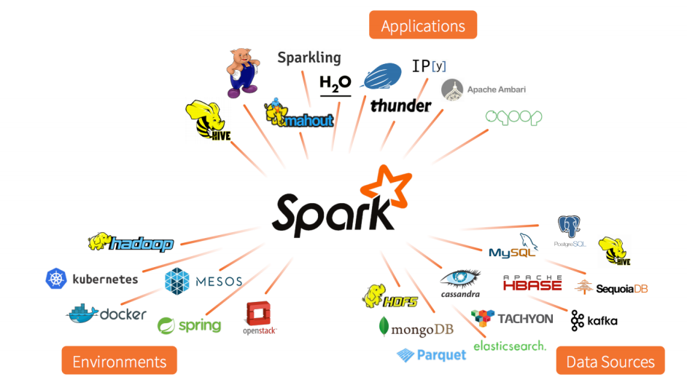
Open source Eco-System

Slide 4
Graphs
GraphX is to RDDs as GraphFrames are to DataFrames
GraphFrames represent graphs: vertices (e.g., users) and edges (e.g., relationships between users).
GraphFrames are based upon Spark DataFrames
GraphX are based upon RDDs

Slide 5
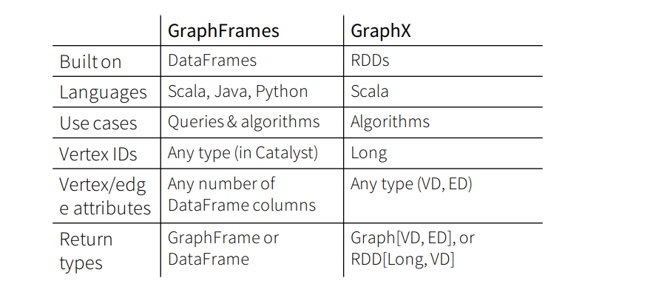
GraphX vs GraphFrames

Slide 6
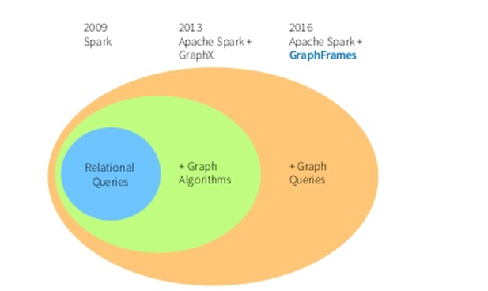
Continued ..

Slide 7
GraphFrames Configuration
https://spark-packages.org/package/graphframes/graphframes
Download first 3 packages in jar
Add them to Spark directory/jars
Refresh sbt
OR
Download Spark 2.3 or 2.1.0
https://spark.apache.org/downloads.html
From Command Line:
Go to bin
spark-shell –packages graphframes:graphframes:0.5.0-spark2.3-s_2.11

Slide 8
Load Pyspark GraphFrames
From PyCharm:
import os
os.environ["PYSPARK_SUBMIT_ARGS"] = (
"--packages graphframes:graphframes:0.5.0-spark2.0-s_2.11 pyspark-shell")
From Command Line:
Pyspark --packages graphframes:graphframes:0.5.0-spark2.0-s_2.11 pyspark-shell

Slide 9
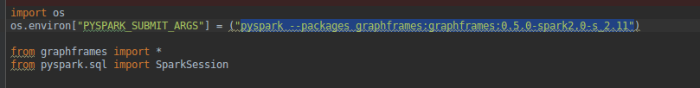
Load in PyCharm or Edit Configuration Settings

Slide 10
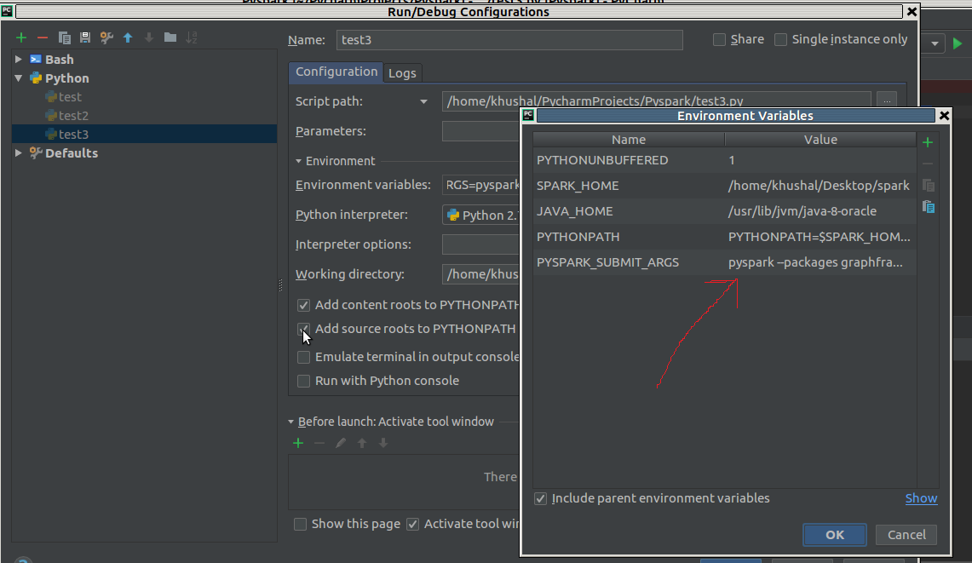
Continued ..

Slide 11
Pyspark command line

Slide 12
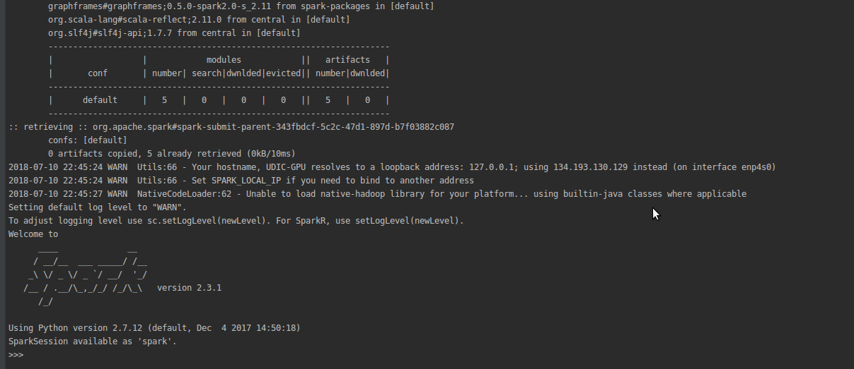
Pyspark Loaded with graphframes

Slide 13
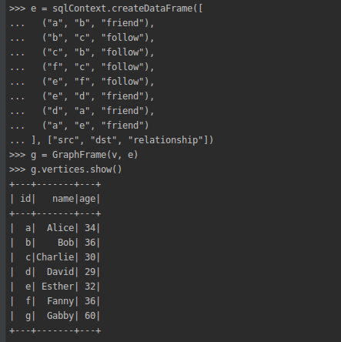
Create Dataframe in Pyspark

Slide 14
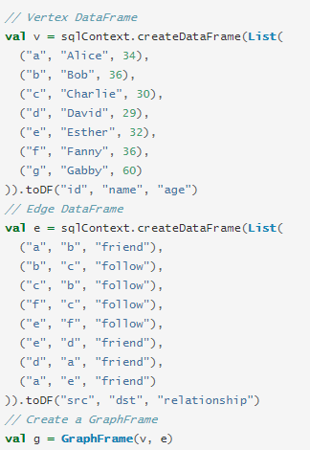
Create Dataframe in Scala

Slide 15
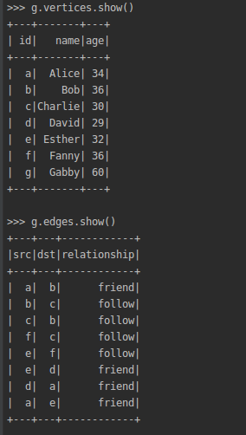
GraphFrames Output

Slide 16
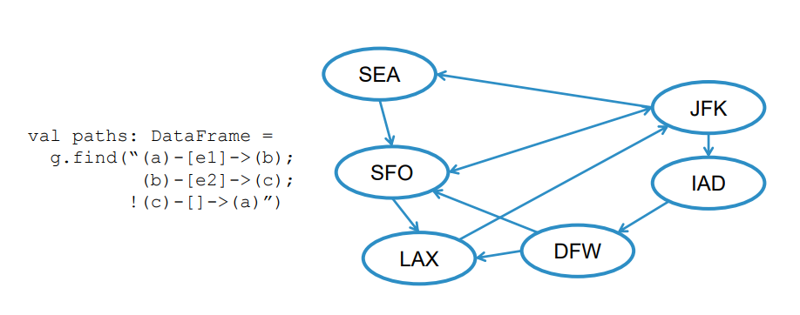
Motif Finding
Search for structural pattern in a graph

Slide 17
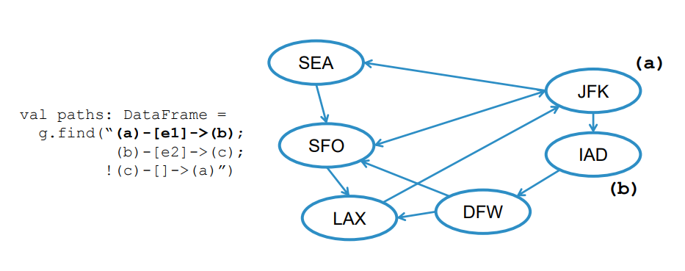
Continued …

Slide 18
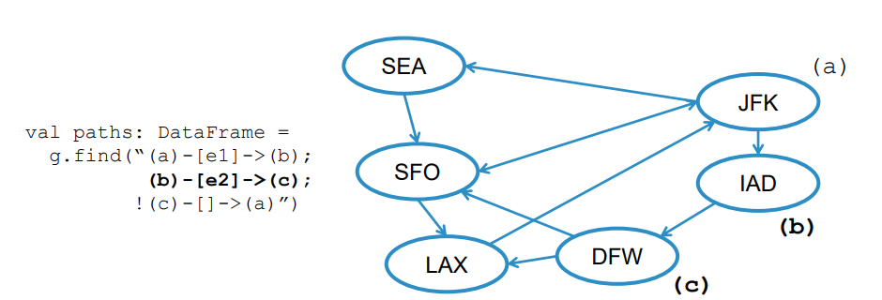
Continued …

Slide 19
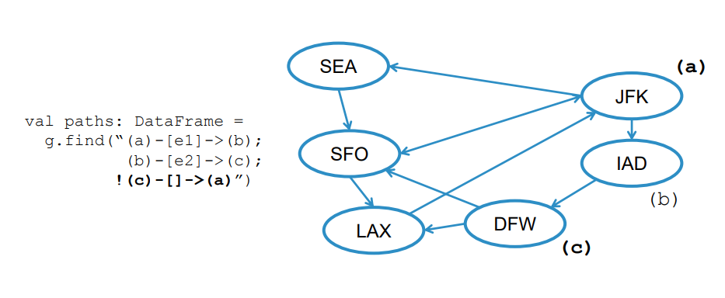
Continued …

Slide 20
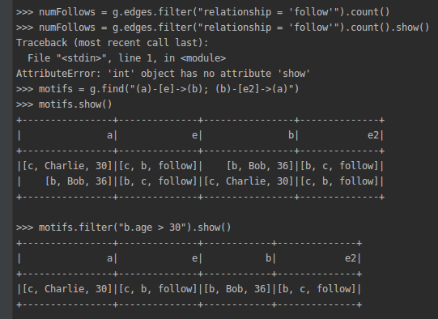
Motifs filter by age (pyspark)

Slide 21
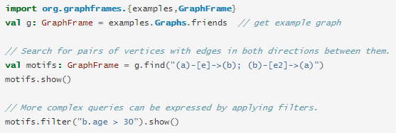
Scala

Slide 22
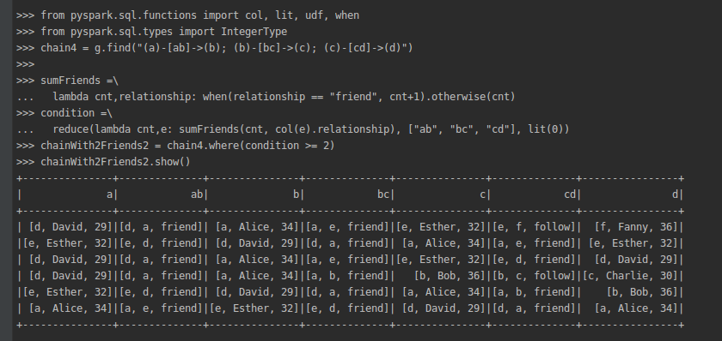
Combination of Relationship (pyspark)

Slide 23
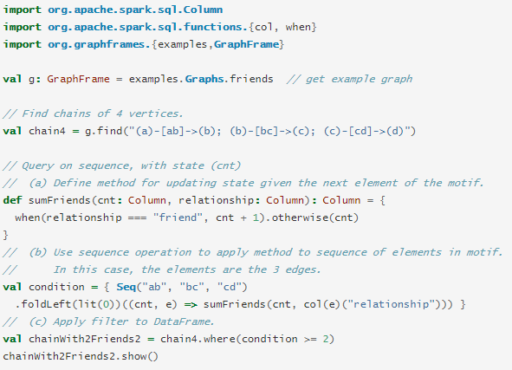
Scala

Slide 24
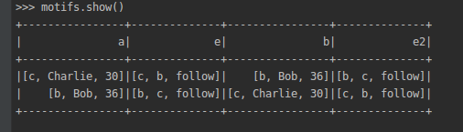
Motif show

Slide 25
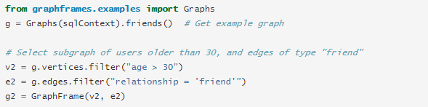
Create Subgraphs (Pyspark)

Slide 26
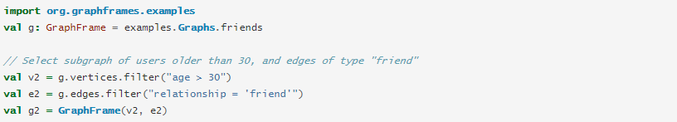
Create Subgraphs (Scala)

Slide 27
References
https://spark.apache.org/docs/latest/graphx-programming-guide.html
http://www.sparktutorials.net/Analyzing+Flight+Data%3A+A+Gentle+Introduction+to+GraphX+in+Sparkhttp://www.sparktutorials.net/Analyzing+Flight+Data%3A+A+Gentle+Introduction+to+GraphX+in+Spark
https://mapr.com/blog/how-get-started-using-apache-spark-graphx-scala/
https://www.edureka.co/blog/spark-graphx/
https://graphframes.github.io/user-guide.html
https://databricks.com/blog/2016/03/03/introducing-graphframes.html

